Slide 1
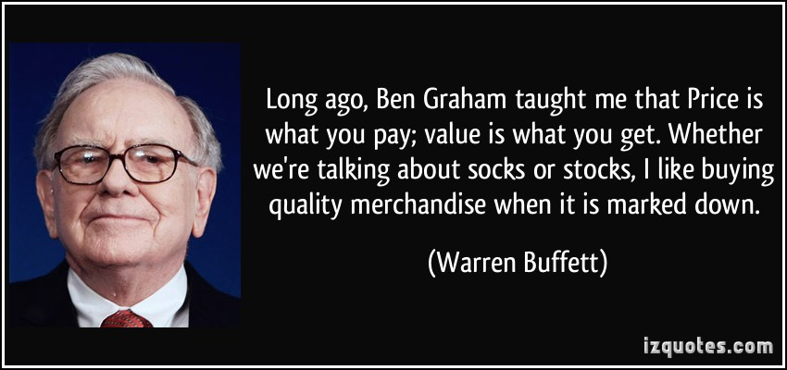
Using machine learning to aid Value Investing decisions.
Samuel Appiah, Rajesh Paul, Prasanth Duvvur
This Photo by Unknown Author is licensed under CC BY

Slide 2
Motivation
Find value investing criteria that influence positive stock returns during bear markets.
Use machine learning algorithms, decision tree, random forest, neural networks, univariate linear regression, kNN( k-nearest neighbor), stock data, financial charts and other technologies to do predictive analysis for stocks.
Validate hypothesis of value investing
Notes:
Consider talking about:
Performance of value strategies
Performance of value investors

Slide 3
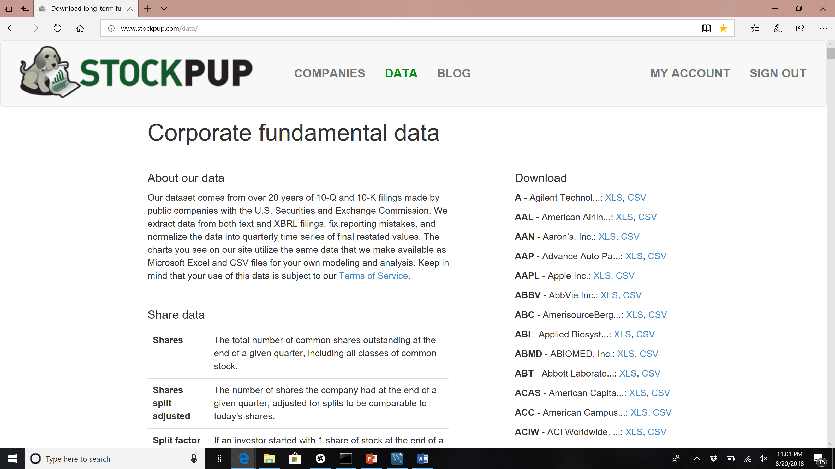
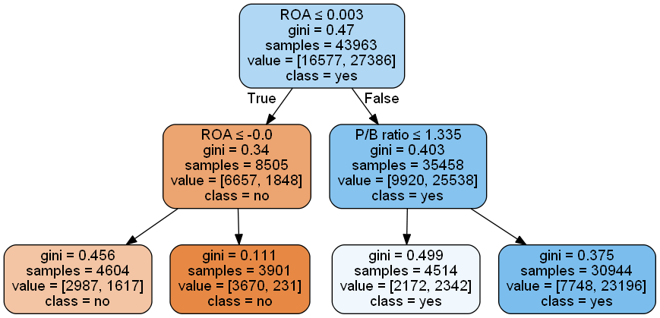
High Level System Design
Machine Learning module
DB
Models
Data Visualization
Data ETL (Python/Pandas)

Slide 4

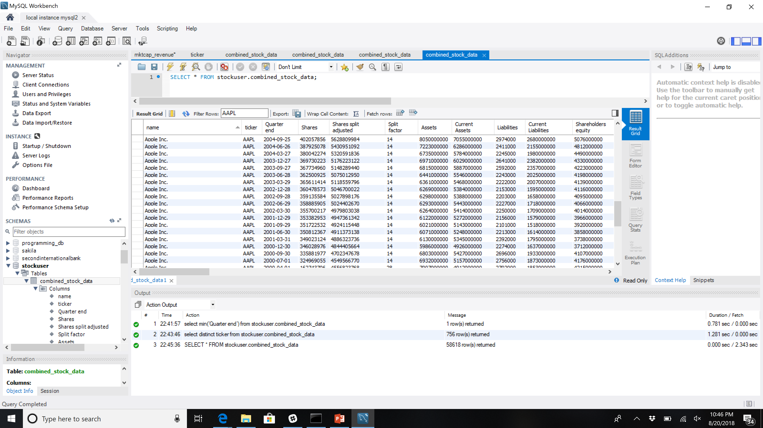
Data collection
Stock data from 1993-2018 – stockpup.com Core US Fundamentals Data, scrape website using python, pandas
Load data into MySQL – 756 stocks
Calculate stock returns, per quarter, per year, two year, three year, five year...
Get company name, ticker symbols from Yahoo!.
Notes:
Consider talking about:
Performance of value strategies
Performance of value investors

Slide 5
Machine Learning – choosing a model

Slide 6
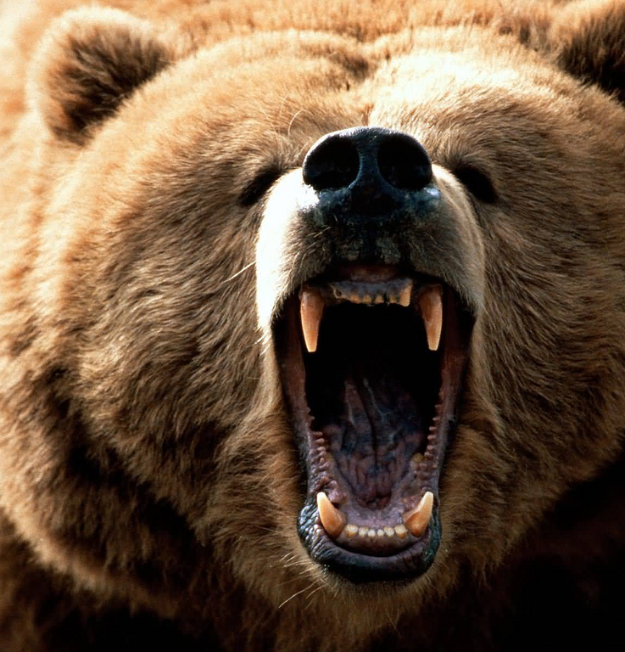
Machine Learning Process Overview
Scrape data,
Load into db
Decision Tree
Choose and run models using crit.
Train
Pick Stocks.
Random Forest
Random Forest
Test
kNN
Use Ensemble of models
Used to find criteria
Neural Networks
Deep model
univ. Linear Regression

Slide 7
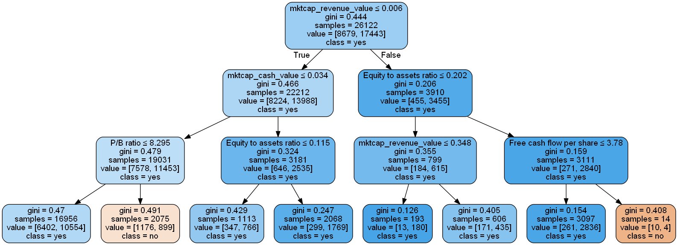
Decision Tree Analysis
Max depth | One | Three | Five | Seven
Full | 0.607250 | 0.602719 | 0.548338 | 0.395770
2 | 0.864048 | 0.805135 | 0.492447 | 0.267371
3 | 0.851963 | 0.790030 | 0.504531 | 0.262839
4 | 0.84138 | 0.761329 | 0.504532
5 |  | 0.761329 | 0.534743
6 |  | 0.752265 | 0.534743

Slide 8
Random Forest Analysis
Feature | 1 year | 3 year | 5 year | 7 year
Score test data | 0.785498 | 0.77039 | 0.495468 | 0.321752
P/B ratio | 0.098436 | 0.10593
Free_cash_flow_per_share | 0.101277 | 0.10539
Equity to assets ratio | 0.102129 | 0.09999
Current ratio | 0.090440 | 0.08683
EPS basic | 0.092523 | 0.08559
ROA | 0.086263 | 0.08429
ROE | 0.084483 | 0.08079
Long-term_debt_to_equity | 0.081662 | 0.08038
P/E ratio | 0.08031 | 0.07998
-Used 200 random trees
RF model gives the best analysis of criteria that influence returns
Conclusion: 3 year is best model to use and the criteria for this can be used.

Slide 9
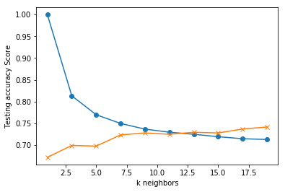
k-NN
Parameters | 1 yr | 3 yr | 5 yr
16 | k=11 Acc: 0.751 | k=9 Acc: 0.754 | k=5 Acc: 0.523
Best 5 |  | k=13 Acc: 0.730
Conclusion: 3 yr with all 16 factors seems best, in line with RF model

Slide 10
Neural Networks
For investment purposes, investors want to go for 3yr time frame. The reason we chose first_year_return, third_year_return, five_year_return.
Imported all the necessary models needed to test and train our data
These data were tested and trained with target dates and ending train date results below:
one_year_return with 8%Normal Neural Network - Loss: 0.5728785550486285, Accuracy: 0.8232628389787818
three_year_return with 24%Normal Neural Network - Loss: 0.651173338789234, Accuracy: 0.5362537769752687
ive_year_return with 40%Normal Neural Network - Loss: 0.7562458124405668, Accuracy

Slide 11
Deep Model
Based on the data trained and tested, the following are the results generated from the deep model networks:
one_year_return with 8%
Deep Neural Network - Loss: 0.5736396660257322, Accuracy: 0.7719033232628398
Two_year_return
Deep Neural Network - Loss: 0.6465942139351836, Accuracy: 0.6404833836858006
deep_model.compile(optimizer='adam',
loss='categorical_crossentropy',
metrics=['accuracy'])
deep_model.fit(
X_train_scaled,
y_train_categorical,
epochs=100,
shuffle=True,
verbose=2
)

Slide 12
Deep Model
Three_year_return
Deep Neural Network - Loss: 0.7590607845891278, Accuracy: 0.563444108671
deep_model = Sequential()
deep_model.add(Dense(units=6, activation='relu', input_dim=16))
deep_model.add(Dense(units=6, activation='relu'))
deep_model.add(Dense(units=2, activation='softmax'))

Slide 13
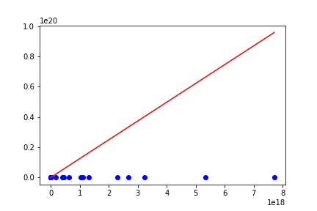
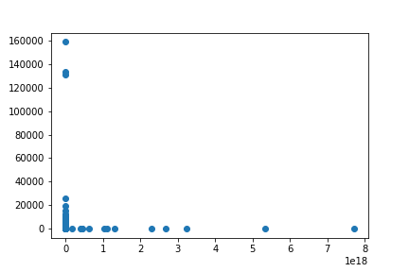
Univariate Linear Regression
Data was not linear
from sklearn.linear_model import LinearRegression
model = LinearRegression()
X=X.reshape(-1, 1)
model.fit(X,y)
model

Slide 14
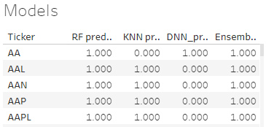
Ensemble model
Decided on using a voting ensemble to combine results from the three selected models
Could not use VotingClassifier from Scikit Learn as it works only with Scikit models
final_pred = np.array([])
for i in range(0,len(X_test)):
final_pred = np.append(final_pred, mode([rf_predictions[i], knn_predictions[i], dnn_predictions[i]]))
test_data_df['Ensemble_predicted_buys'] = final_pred

Slide 15
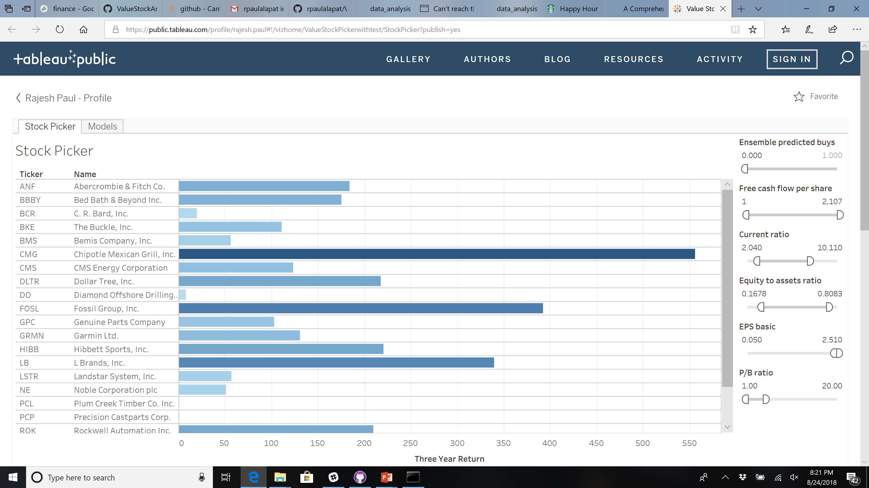
Picking Stocks (bear mkt 2009)
Tableau link

Slide 16
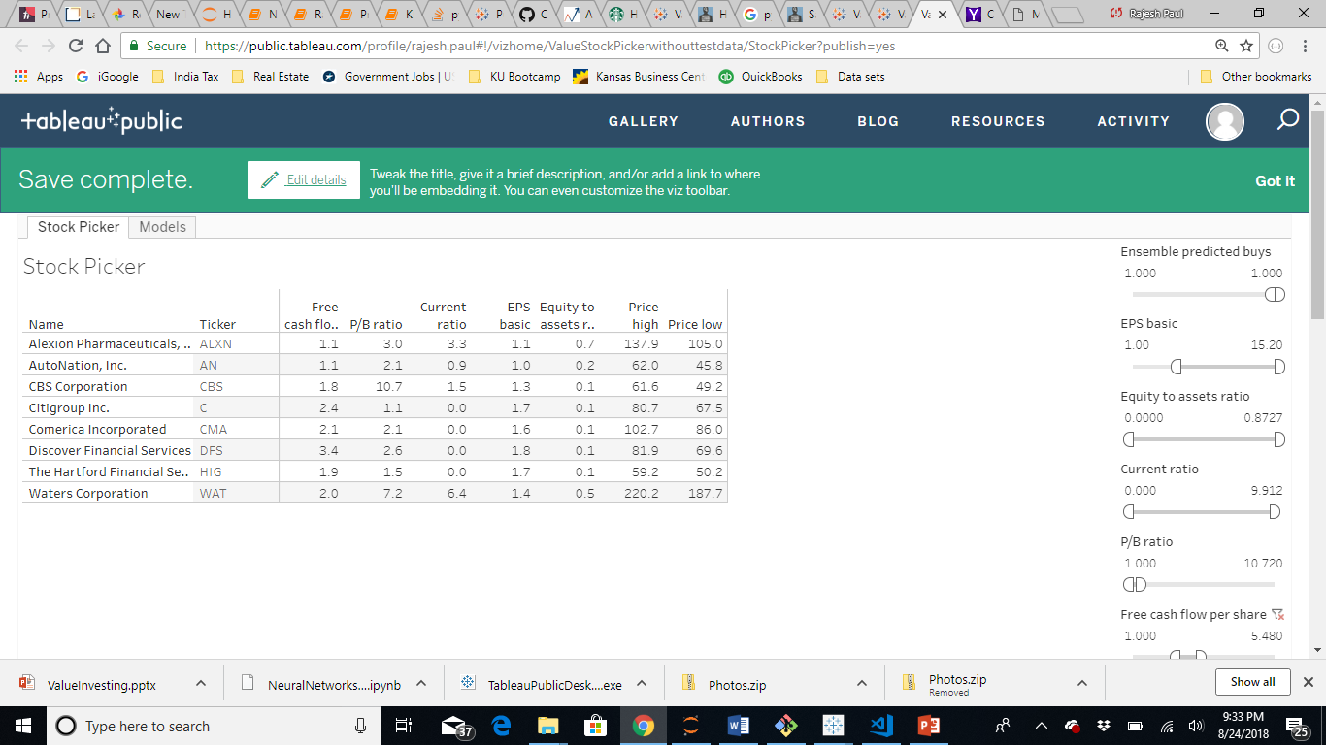
Picking stock for future
Tableau link

Slide 17
Findings/Conclusions
The top 5 factors for determining stock value per our analysis (decision tree, RF) are Free cashflow per share. Equity to assets ratio, P/B ratio, EPS, Current Ratio, ROA, ROE, Debt to Equity ratio and P/E ratio. However in all models seemed to perform better with more criteria than limiting to just these.
The best accuracy for the models is 3 years, meaning the predictions are most valid for an investment period of 3 years.
The models are at best only a guide to select the stocks and the factors. With the average accuracy about 65% which is not very predictive , there are obviously other factors at play and we need to study each of the suggested stocks (or others) before making a decision.
Notes:
Consider talking about:
Performance of value strategies
Performance of value investors

Slide 18
Future
Analyze more stock performance criteria
More years of stock data
More sophisticated predictive analysis and modeling by fine tuning
Try the model in the real world
Notes:
Consider talking about:
Performance of value strategies
Performance of value investors

